Slide 1
Civil Air Patrol Automatic Image Annotation
Connor Grimberg & Joseph Lee
Under our Directors Mr. White & Dr. Gabor

Slide 2

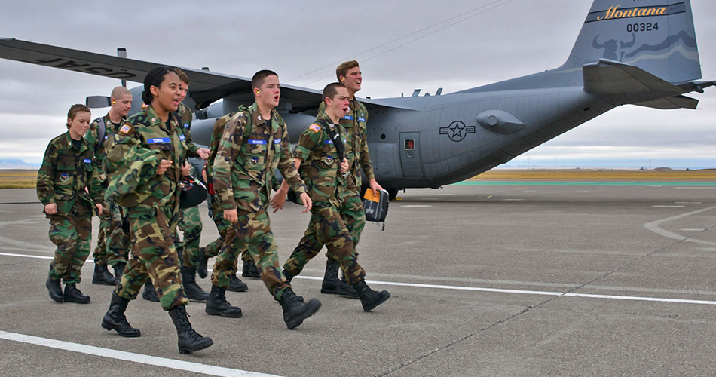
Civil Air Patrol (CAP)
3 depts.
Air force military cadets
Aerial photos of disaster area
Used for: disaster assessment and / or search & rescue

Slide 3
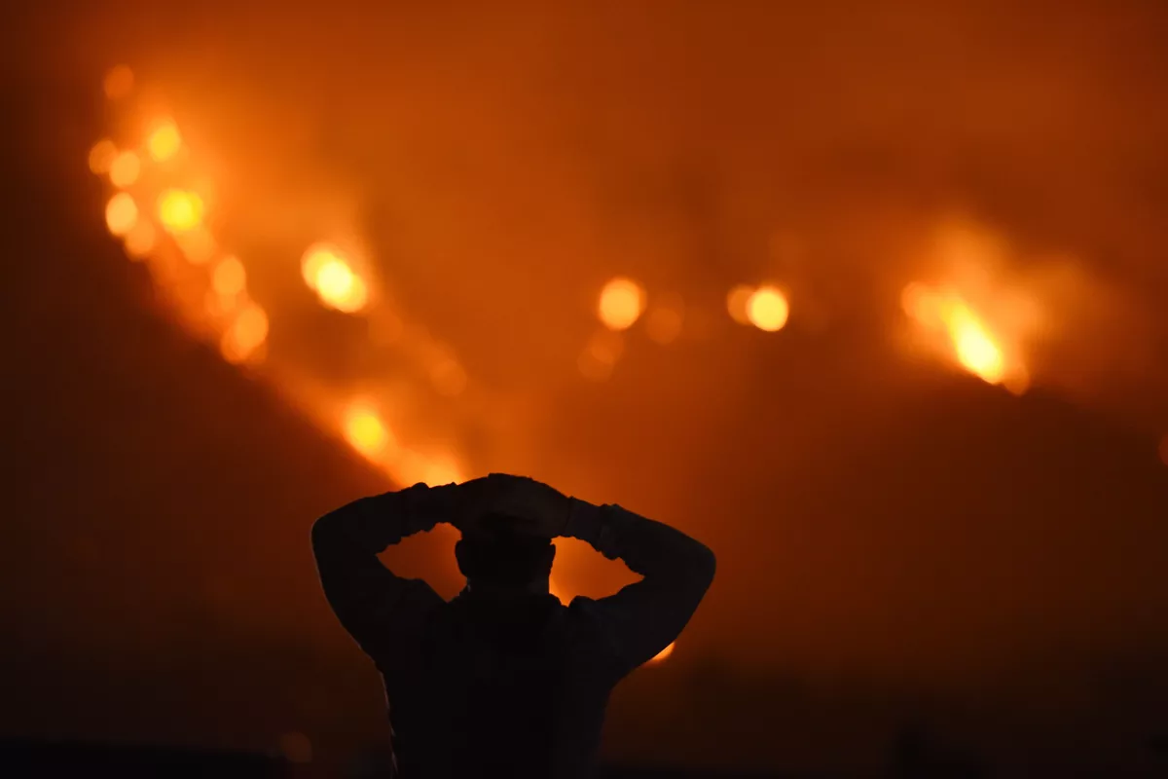

The Problem / Motivation
Disaster response = slow
Lives on the line!
Reduce time with automation
Notes:
https://communities.geoplatform.gov/disasters/civil-air-patrol-cap-browser/
The Civil Air Patrol (CAP) is a nonprofit corporation that assists people in need of help especially after a disaster, most commonly a hurricane. CAP provides numerous aerial imagery of inundated areas, failed dams and things relating to natural disasters. Analysis of the imagery aids FEMA in the decisions process leading to more effective, survivor centric, response. Currently, the workers at CAP upload and annotate thousands of images by hand.
State of the art: CAP
Next-Generation ICS

Slide 4

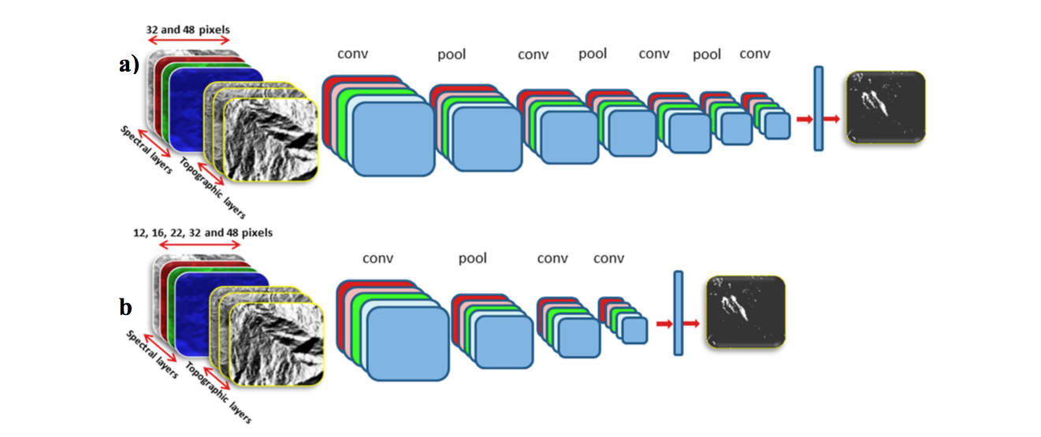
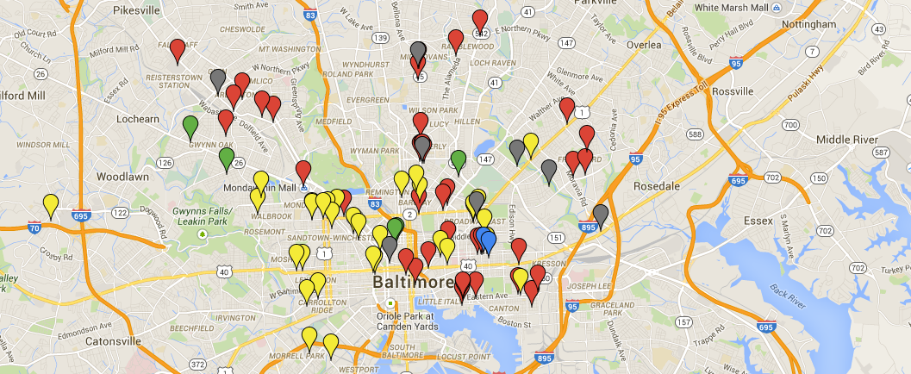
Our Solution
Easy-to-use web application
Input: image folder
Output: Autonomous annotation
Severity rating → map → rescue teams
Using A.I. techniques (e.g. Convolutional Neural Networks (CNN))
Notes:
We want to create a program that can take many images and autonomously annotate them, so workers at CAP won’t have to. We would also like to include several features such as, severity rating of each picture/location, and an easy-to-use website that helps navigate the large amount of images CAP takes.
Disaster map?

Slide 5
Proposal (Formally)
We are creating an Artificially Intelligent website application on behalf of the Civil Air Patrol and related disaster team responders to significantly speed up the disaster response process.

Slide 6
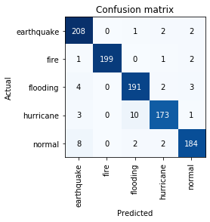
Progress So Far: CNN
4.40% error
Overfitted concern
However, fast.ai validation testing
Google Images
Search for more data
Federal Emergency Management Agency
Civil Air Patrol

Slide 7
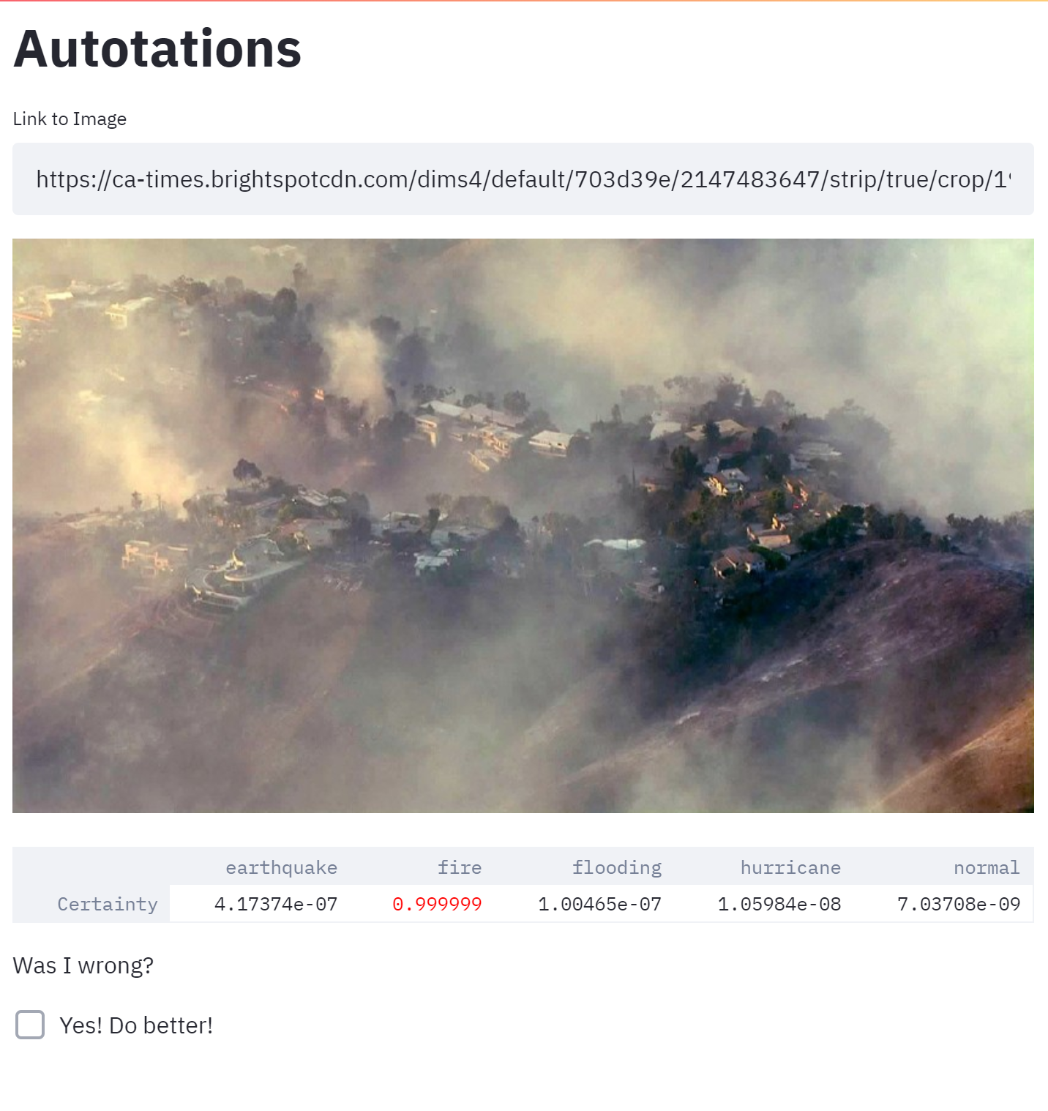
Web App
streamlit2.sites.tjhsst.edu
New software: Streamlit
Compatible with Director
Input: Link
Output: Annotations (Basic)

Slide 8
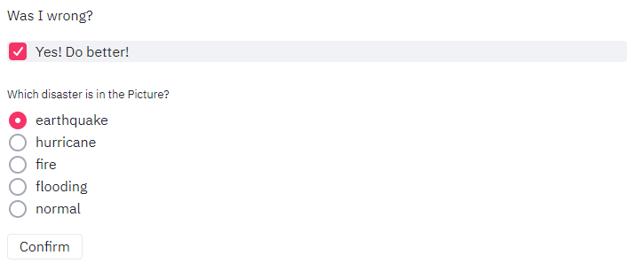
Retrain
Goal: automatically retrain our CNN when it gives a wrong answer
User response
Possible abuse of system
Update dataset → Retrain → Update CNN

